Slide 1
Examining the Relationship Between Executive Control and Student Learning Behaviors
Jared Linck, Tracy Tomlinson, Megan Masters, Alia Lancaster, Martyn Clark, Michal Balass
Nov. 17, 2018
Notes:
The 59th annual meeting Psychonomic Society Logo

Slide 2
Growth in learner data
Increased interest in capturing students’ online learning activities
Examining micro-behaviors through Learner Management System (LMS) usage
Growing demand for learning analytics
Notes:
Icons depicting that computer mouse clicks can be transformed into learning analytics.

Slide 3
Research on Learning Analytics
Most focus on online or blended courses
Mixed results on how LMS usage facilitates learning (Gasevic et al. 2016)
Inconsistency in measuring “LMS usage”
Predictive power varies by course type
More use does not always mean more engagement and/or learning (Halverson et al., 2014; You, 2016)
Notes:
e.g., engaging in > total viewing time

Slide 4
Research on Learning Analytics Challenges
Lack of research exploring how cognitive factors may influence learning activity patterns within an LMS
Goal: Empirically examine individual differences in cognitive processes, LMS usage, and learning outcomes

Slide 5
Methods
Students in two psychology courses
Research methods: N = 121
Statistics: N = 119
LMS usage variables and course grades
Cognitive tasks completed online for course extra credit

Slide 6
Learning Management System (LMS)
Notes:
Screenshot of UMD’s Enterprise Learning Management System (aka ELMS-Canvas). It can be a common course space online for instructors and students.

Slide 7
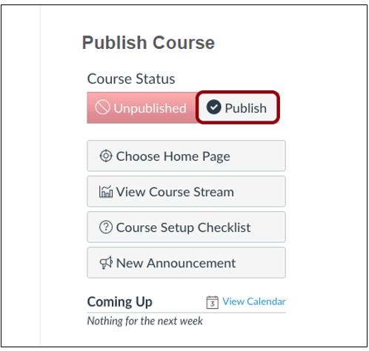
Learning Management System (LMS)
Notes:
Screenshot of Publish button in ELMS-Canvas. Each semester a space is automatically generated within our ELMS-Canvas instance (with exception of some types of sections, like independent study). Only when an instructor publishes a space do students have access to it.

Slide 8
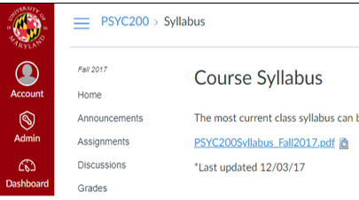
Statistics and Research Methods Courses
Notes:
Screenshot of syllabus page in ELMS-Canvas. Illustrates the first place students often navigate to. If a student spends 1 minutes on this page, this represents one minute of time in the course space.

Slide 9
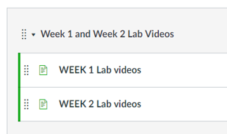
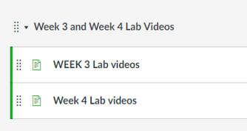
Notes:
Screenshot of the modules page. Illustrates that if students click on the modules link from the syllabus page, this represents two page views in the course. Our two LMS variables were time in the course space and page views.

Slide 10
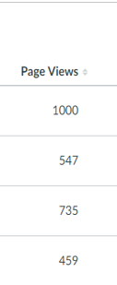
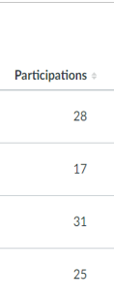
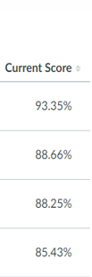
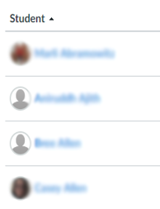
LMS variables
Page views
Time in course space (minutes)
# submissions
Current score
Notes:
Screenshot of data from analytics dashboard in LMS. Illustrates where we mined the page views, time in course space, number of submissions, and current score variables.

Slide 11
Course grades
Three exams
Two written news article assignments
Participation score
Homework assignments score
Extra credit
Final grade (%)
**Outcome in analyses = Final Score

Slide 12
Cognitive tasks
Construct | Measure
Explicit rule induction | Letter Sets
Implicit rule induction | Serial Reaction Time task
Inhibitory control | Antisaccade
Task switching | Task Switching—Numbers
Working memory updating | Running Memory Span

Slide 13
Analysis
Courses analyzed separately
Cognitive task scores were standardized prior to analysis
Correlations (bivariate relationships)
Multiple regressions (moderation analysis)

Slide 14
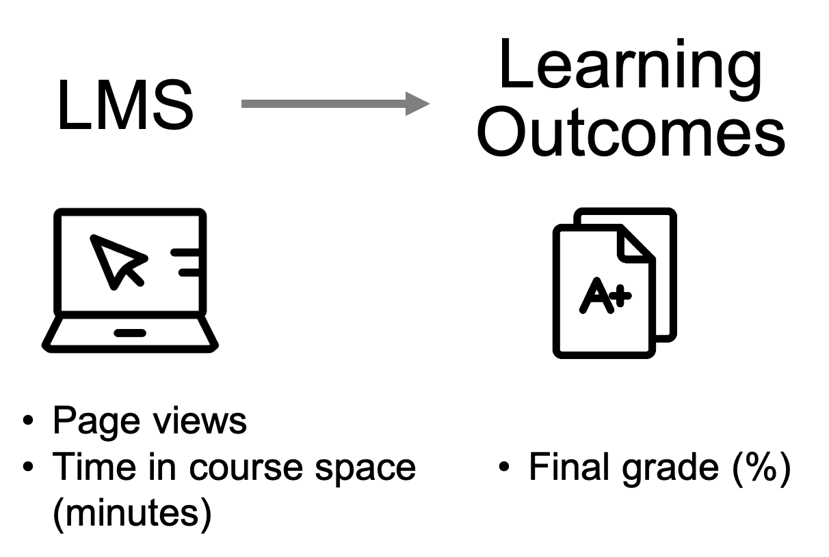
RQ1: Is LMS usage related to learning outcomes?
Notes:
Icons representing that LMS behavior was operationalized as page views and time in course space (minutes) and learning outcomes were operationalized as final grade (%).

Slide 15
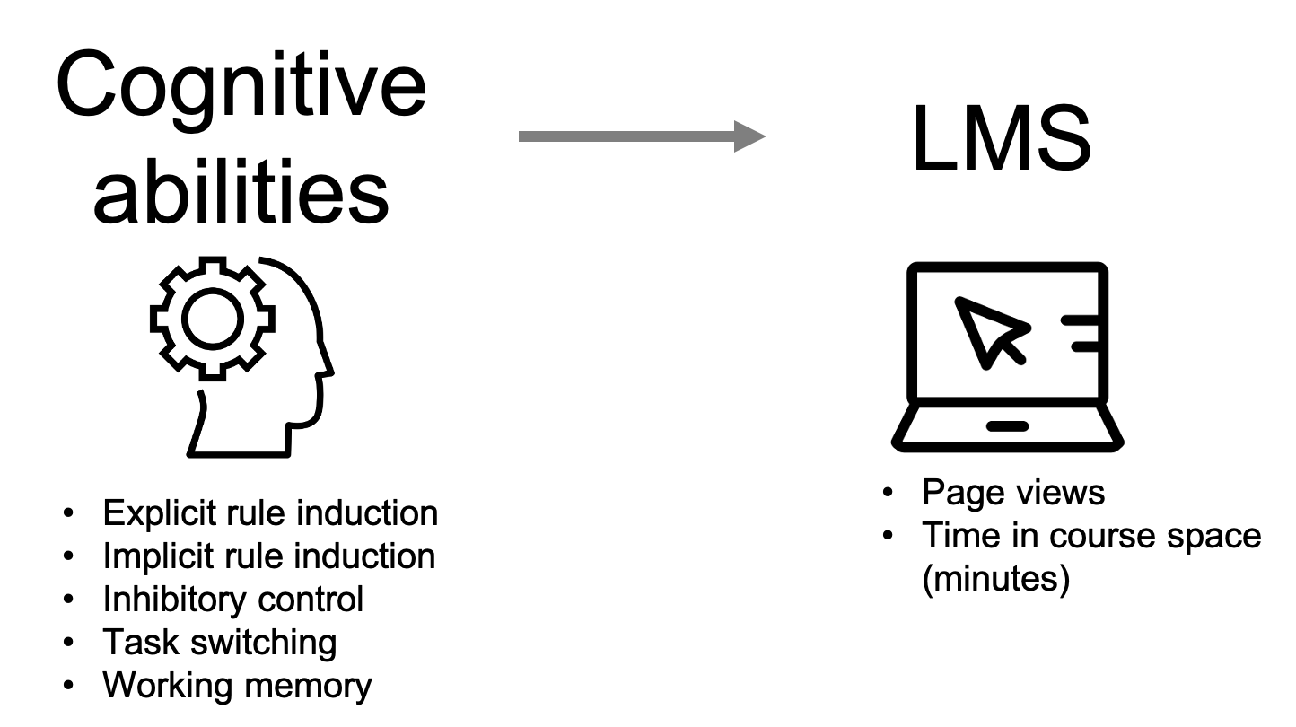
RQ2: Are cognitive abilities related to LMS usage?
Notes:
Icons representing that cognitive abilities were operationalized as explicit rule induction, implicit rule induction, inhibitory control, task switching, and working memory. LMS usage was operationalized as page views and time in course space (minutes).

Slide 16
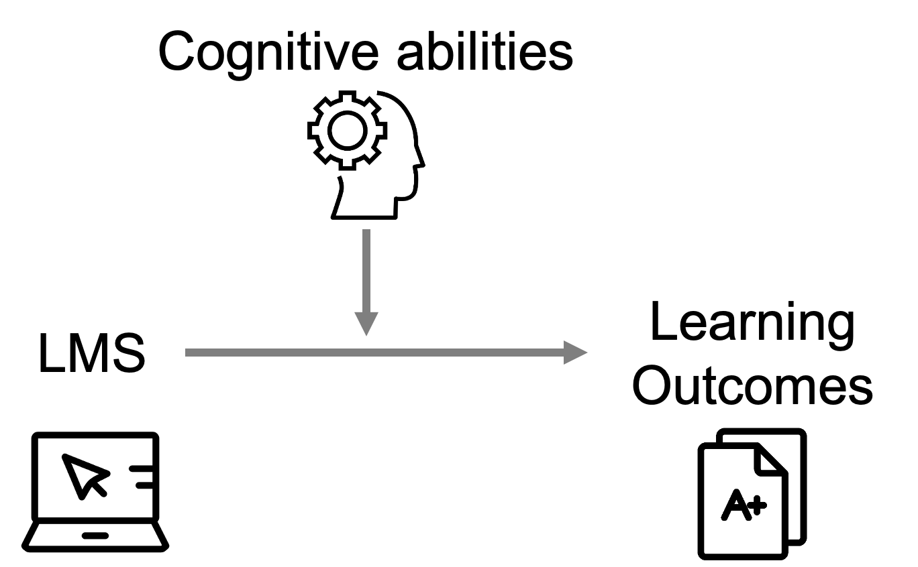
RQ3: Do cognitive abilities moderate the effects of LMS usage on outcomes?
Notes:
Icons representing the RQ3 model. Is the relationship of LMS variables on learning outcomes changed when students' cognitive abilities are considered?

Slide 17
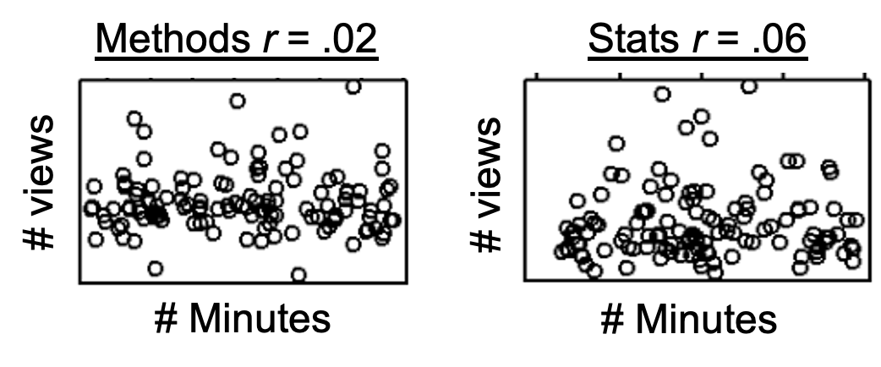
Results
LMS page views & total minutes unrelated
Fewer than half of participants completed cognitive measures
Notes:
Two scatter plots showing the relationship between the number of minutes in the course and the number of page views. This relationship was not significant for the methods course (r=.02) nor the stats course (r=.06).

Slide 18
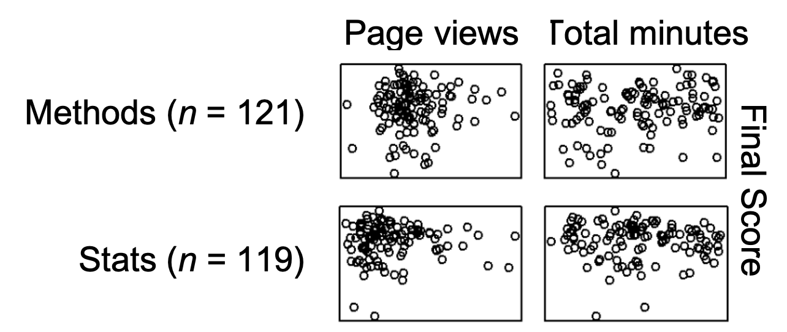
RQ1: LMS & outcomes
No significant correlations between global LMS usage and Final course grade
Notes:
4 scatterplot graphs of the relationship between final score and page views and total minutes in the methods (n=121) and stats (n=119) course. No significant patterns emerged.

Slide 19
RQ2: Cognitive & LMS
Analyzed subset with cog scores
Methods n = 44, Stats n = 48
No significant correlations between global LMS usage and cognitive measures
Largest numerical correlations in .20s, for Methods course
Fewer total minutes might correlate with:
Better WM updating (r = -.22)
Worse shifting (r = -.24)
Notes:
Caution icon representing that caution should be used when interpreting these results.

Slide 20
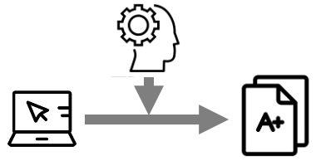
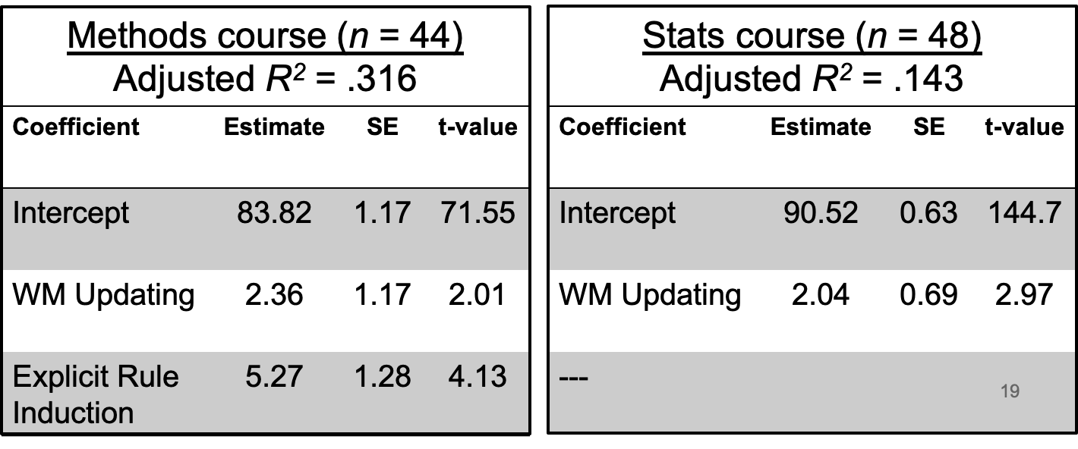
RQ3: Interactions
Best-fitting models had no interactions
Final Grade only related to WM Updating and Explicit Rule Induction
Notes:
Regression output tables for each course. The significant predictors in the methods course were WM updating and explicit rule induction. The significant predictor in the stats course was WM updating.

Slide 21
Summary of Findings
Simple measures of amount of LMS usage unrelated to Final Course Grades
Cognitive processes unrelated to amount of LMS usage

Slide 22
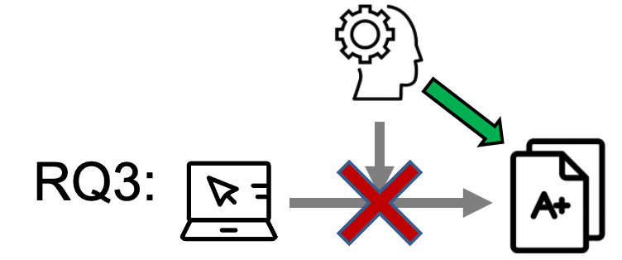
Summary of Findings (cont.)
Final Course Grades
Better WM Updating and Explicit Rule Induction related to better outcomes
No interactions between LMS usage and cognitive processes
Notes:
Icon depicting that while LMS behaviors were not related to final grades, some cognitive measures were related to final grades.

Slide 23
Potential Factors
Course format
Face-to-face vs. blended vs. online
LMS familiarity
LMS usage measures too “broad”
Clear need for more nuanced measures of learning related to course activities

Slide 24
Future Directions
Move to more sophisticated quantitative and qualitative analyses
LMS ‘user styles’ – e.g., active, passive, bystander (Tseng et al., 2016)
Sequential pattern modeling
Examine links between cognitive processes and specific learning behaviors

Slide 25
Conclusions
Novel research at the intersection of cognitive abilities, educational measurement, and learning analytics
Potential for LMS usage data and cognitive measures to enable personalized instruction

